Slide 1

E-VISITORS HUB
TS- WEB TRACK CAPSTONE PROJECT
Presented By TEAM CODEBLASTERS:
1. MEGHANA TAMRAKAR – APS University Rewa (BCA)
2. PRIYAMVADA SINGH – APS University Rewa (BCA)
3. SAKSHI PATEL – APS University Rewa (MCA)
4. SUHANI SRIVASTAVA – APS University Rewa (MCA)
Guided By: Miss. VISHRUTI PRAJAPATI

Slide 2
OUTLINE
Abstract
Problem Statement (Should not include solution)
Aims , Objective & Proposed System/Solution
System Architecture
System Development Approach(Technology Used)
Algorithm & Deployment
Conclusion
References
Future Scope

Slide 3
Abstract
As rewa is such a big city and outside visitors come here and wander here and there because they don't have much knowledge about the things. So,this project is conducted under the objective of design and development of a place information for the users and visitors.
E-visitor Hub is something which points out the way and leads others on a trip or tour. Generally, this will work at a specific location, city or province. AND with this we are focusing in the REWA city.

Slide 4
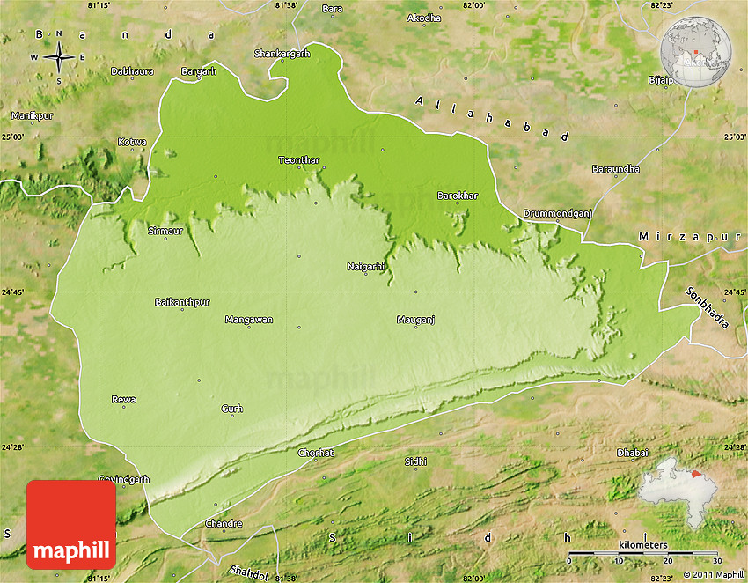
Problem Statement
As rewa is such a big city and outside visitors come here and wander here and there because they don't have much knowledge about the things. So,this project is conducted under the objective of design and development of a place information for the users and visitors. In this project,the overall information provided to the visitors are based on the research,analysis and results. Through this project, users are able to shorten the time taken for the processes and they can manage the things accordingly. And this project is further improving from many aspects since it could be always updated and modified according to the user need and convenience and users will also be able to provide feedback and add comment for further improvisation.
PHYSICAL MAP OF REWA

Slide 5
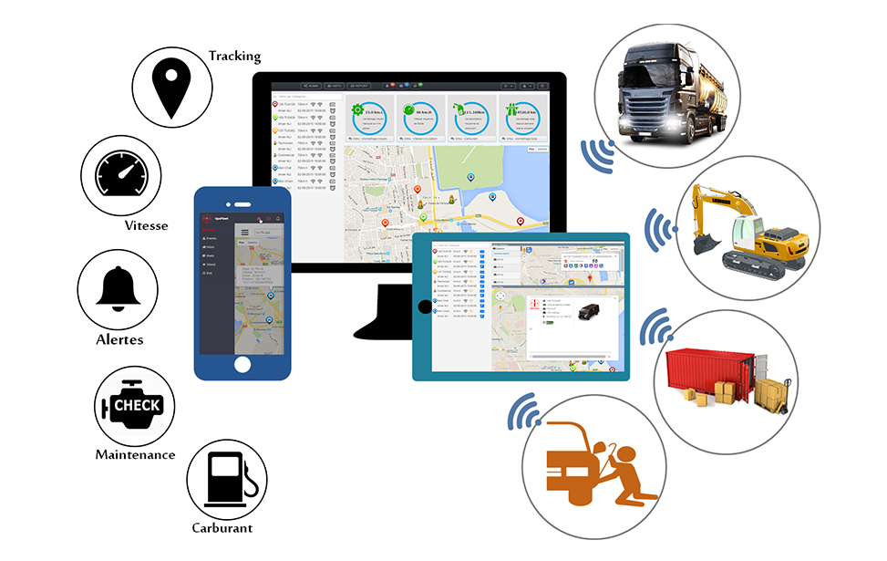
Proposed Solution
With the help of GPS tracking, providing correct exact all information to the visitors, they will be able to find and visit the appropriate places as well as providing images so that they can visualize and identify that the place is right.
ANOTHER method would be we can make website related to these stuff so that visitors browse over there and find all correct information regarding the things and appropriate places.

Slide 6
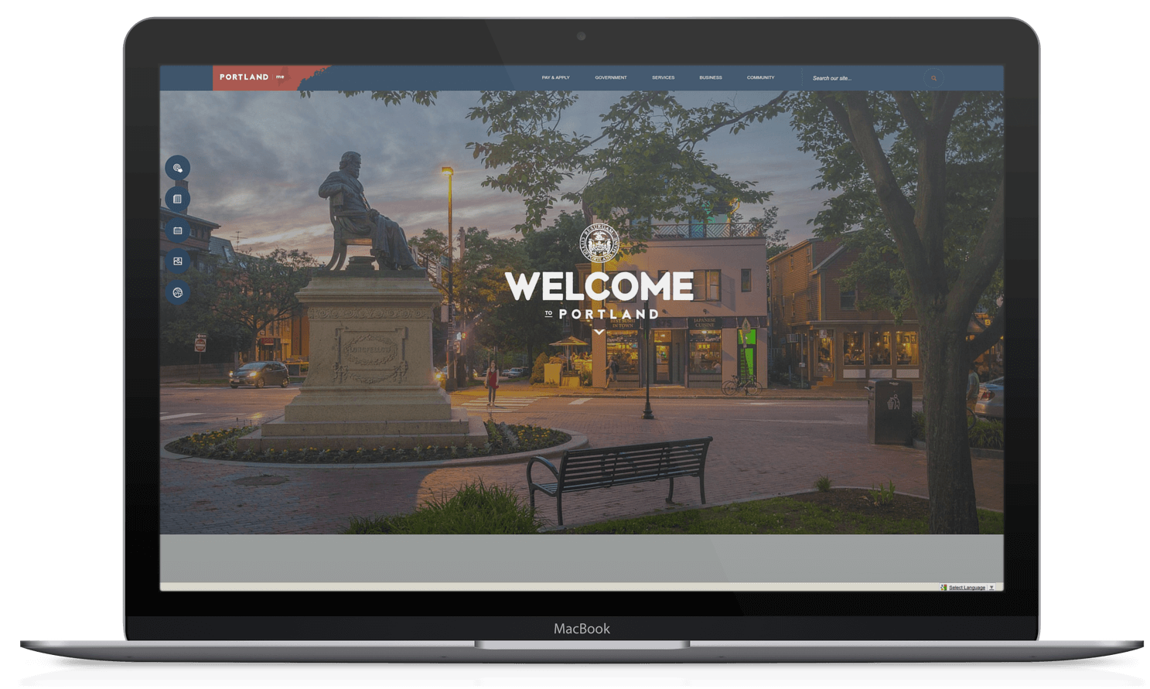
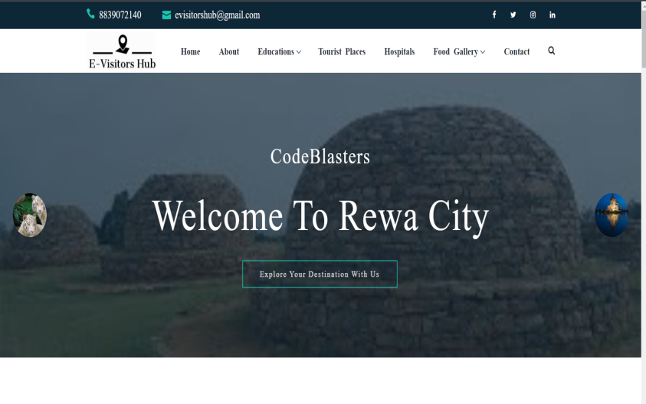
System Architecture
The system architecture and working of our website will be like this. First of all we will start with the home page, so in home page all the contents will briefly explained and there is a slight overview of each of things of the website.
Then we will go through each and every pages to which we are looking for such as hospitals in rewa, educational institutes in rewa, tourists places, food and staying facilities in rewa and many more. Along with this, if the visitors wants some updates then he can also give feedback using their email address. And they can also contact us whenever they need our help.

Slide 7
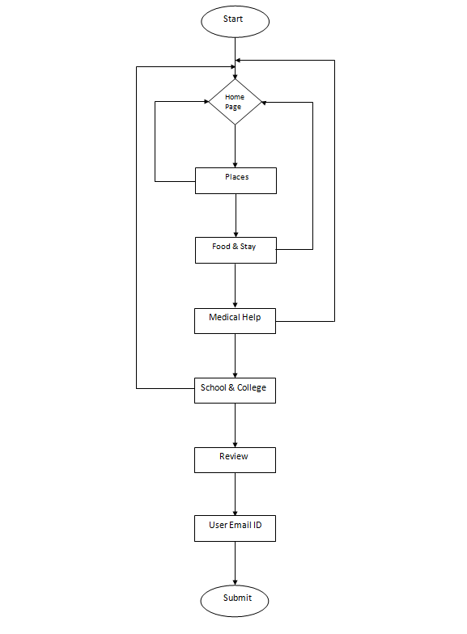
Algorithm & Deployment

Slide 8
Technologies and Requirements
TECHNOLOGY USED:
Front end: HTML, CSS, Javascript, Bootstrap
Back end: php, MySQL ,jquery
HARDWARE REQUIREMENTS:
A smart device, monitor, processor-i3 with SSE2 instruction set, Minimum 2-GB RAM, A hard disk of 50-GB.
SOFTWARE REQUIREMENTS:
Internet availability, Windows 7 or higher, text editor for better programmimg environment, XAMP/VAMP server, MySQL.

Slide 9
Conclusion
This project is conducted under the objective of design and development of a place information for the users and visitors. In this project,the overall information provided to the visitors are based on the research,analysis and results. Through this project, users are able to shorten the time taken for the processes and they can manage the things accordingly.
This project can be further improving from many aspects since it could be always update and modify according to the users need and convenience.

Slide 10
References
https://www.w3schools.com/html/
https://www.w3schools.com/html/html_css
https://www.tutorialspoint.com/
https://www.javatpoint.com/
https://www.tutorialrepublic.com/
https://codeofaninja.com/
https://careerfoundry.com/

Slide 11
Future Scope
Our project will be updated and modified according to the users need and convenience.
Furthur more, we will
collaborate with the cabs to facilitates users.
provide chat bots for users more convenience.
update new places in future according to visitors interest.

Slide 12
THANK YOU

